Slide 1
Automatic Speech Recognition
Ying shen
School of software engineering
Tongji university

Slide 2
Outline
Introduction
Speech recognition based on HMM
  Acoustic processing
  Acoustic modeling: Hidden Markov Model
  Language modeling

Slide 3
What is speech recognition?
Automatic speech recognition(ASR) is the process by which a computer maps an acoustic speech signal to text.
Challenges for researchers
  Linguistic factor
  Physiologic factor
  Environmental factor

Slide 4
Classification of speech recognition system
Users
  Speaker dependent system
  Speaker independent system
  Speaker adaptive system
Vocabulary
  small vocabulary : tens of word
  medium vocabulary : hundreds of words
  large vocabulary : thousands of words
  very-large vocabulary : tens of thousands of words
Word pattern
  isolated-word system : single words at a time
  continuous speech system : words are connected together

Slide 5
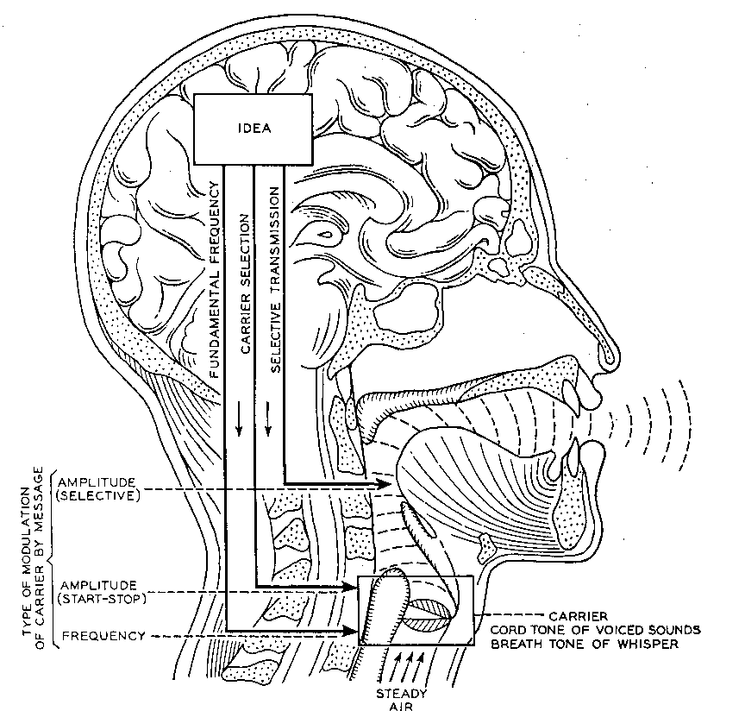
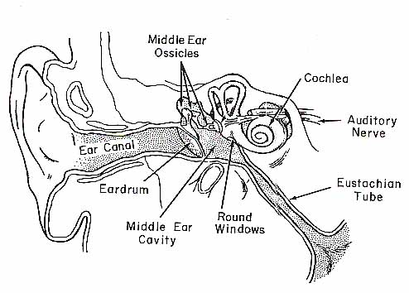

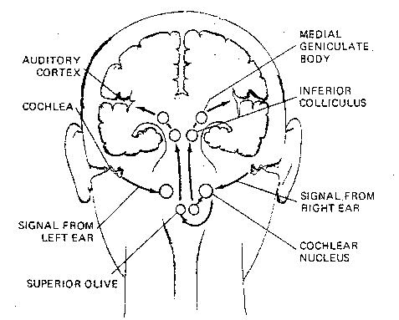
How do human do it?
Articulation produces sound waves
Which the ear conveys to the brain
for processing

Slide 6
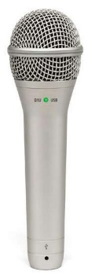
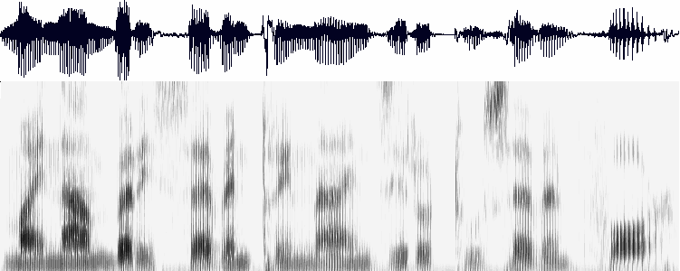
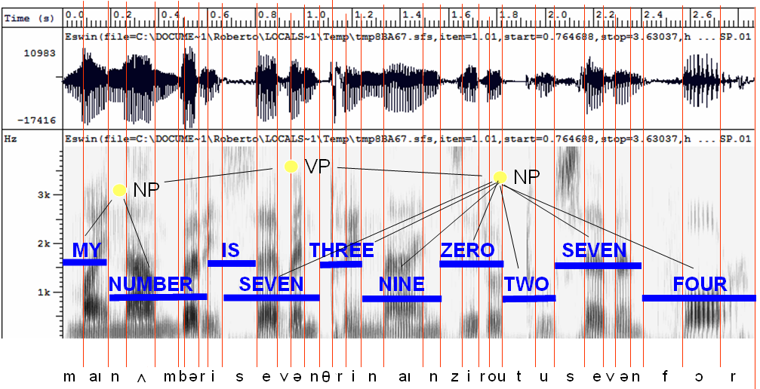
How might computers do it?
Digitization
Acoustic analysis of the speech signal
Linguistic interpretation
Acoustic waveform
Acoustic signal
Speech recognition

Slide 7
Outline
Introduction
Speech recognition based on HMM
  Acoustic processing
  Acoustic modeling: Hidden Markov Model
  Language modeling
  Statistical approach

Slide 8
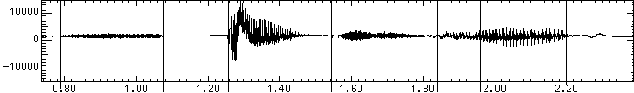

Acoustic processing
A wave for the words “speech lab” looks like:
s p ee ch l a b
“l” to “a”
transition:
Graphs from Simon Arnfield’s web tutorial on speech, Sheffield:
http://lethe.leeds.ac.uk/research/cogn/speech/tutorial/

Slide 9
Acoustic sampling
10 ms frame (ms = millisecond = 1/1000 second)
~25 ms window around frame to smooth signal processing
25 ms
. . .
10ms
Result:
Acoustic Feature Vectors
a₁ a₂ a₃

Slide 10
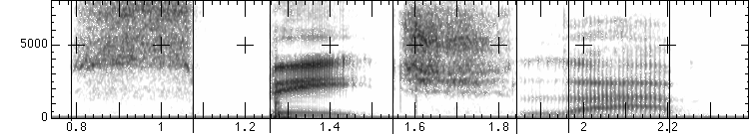
Spectral analysis
Frequency gives pitch; amplitude gives volume
  sampling at ~8 kHz phone, ~16 kHz mic (kHz=1000 cycles/sec)
Fourier transform of wave yields a spectrogram
  darkness indicates energy at each frequency
  hundreds to thousands of frequency samples
s p ee ch l a b
amplitude
frequency
Notes:
那我们为什么要在声谱图中表示语音呢？
首先，音素（Phones）的属性可以更好的在这里面观察出来。另外，通过观察共振峰和它们的转变可以更好的识别声音。隐马尔科夫模型（Hidden Markov Models）就是隐含地对声谱图进行建模以达到好的识别性能。还有一个作用就是它可以直观的评估TTS系统（text to speech）的好坏，直接对比合成的语音和自然的语音声谱图的匹配度即可。
http://blog.csdn.net/zouxy09/article/details/9156785

Slide 11
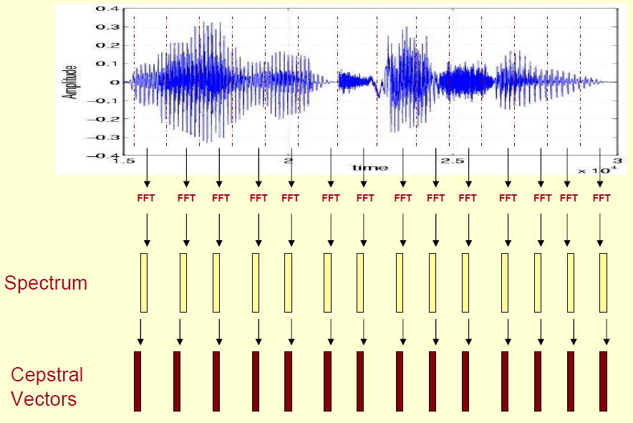
Mel-frequency cepstrum coefficients
MFCC are mostly used features in state-of-art speech recognition system
Notes:
http://www.speech.cs.cmu.edu/15-492/slides/03_mfcc.pdf

Slide 12
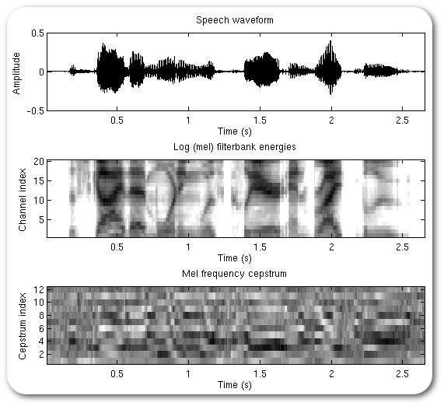
Mel-frequency cepstrum coefficients

Slide 13
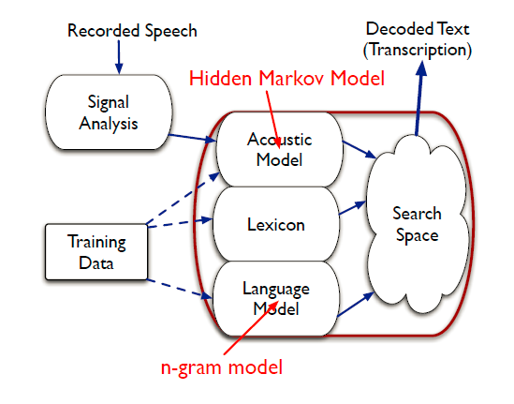
Statistical speech recognition

Slide 14
Outline
Introduction
Speech recognition based on HMM
  Acoustic processing
  Acoustic modeling: Hidden Markov Model
  Language modeling

Slide 15
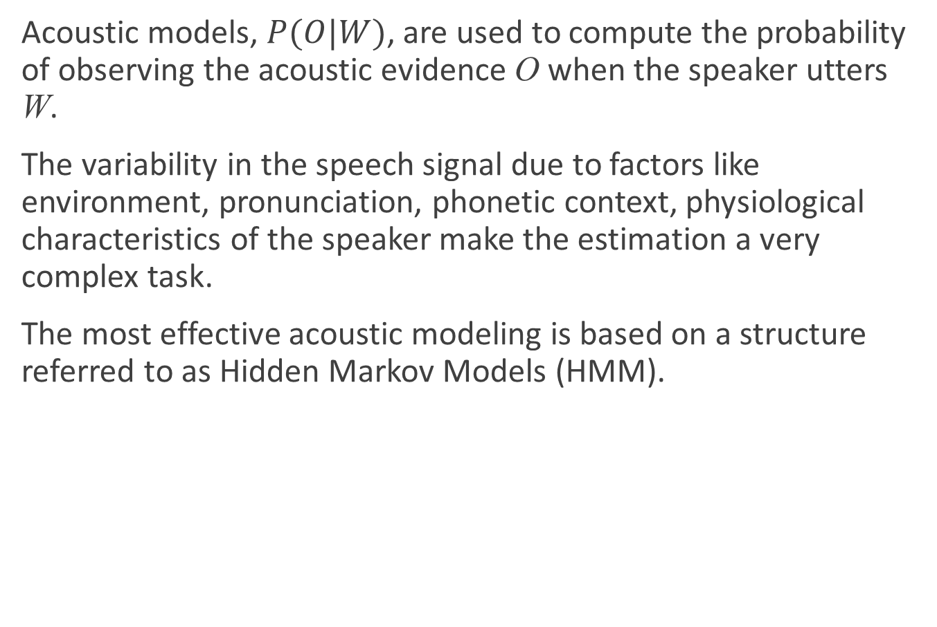
Acoustic modeling: Hidden Markov Model
Acoustic models, $P(O|W)$, are used to compute the probability of observing the acoustic evidence O when the speaker utters W.
The variability in the speech signal due to factors like environment, pronunciation, phonetic context, physiological characteristics of the speaker make the estimation a very complex task.
The most effective acoustic modeling is based on a structure referred to as Hidden Markov Models (HMM).

Slide 16
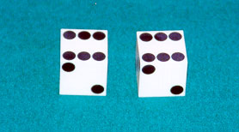
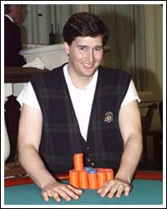
HMM
Example: The dishonest casino
A casino has two dice:
  Fair die
  P(1) = P(2) = P(3) = P(4) = P(5) = P(6) = 1/6
  Loaded die
  P(1) = P(2) = P(3) = P(4) = P(5) = 1/10
  P(6) = 1/2
Casino player switches between fair and loaded die with probability 1/20 at each turn

Slide 17
HMM
Game
  You bet $1
  You roll (always with a fair die)
  Casino player rolls (maybe with fair die, maybe with loaded die)
  Highest number wins $2

Slide 18
The dishonest casino model
0.05
0.95
0.95
FAIR
LOADED
0.05
P(1|F) = 1/6
P(2|F) = 1/6
P(3|F) = 1/6
P(4|F) = 1/6
P(5|F) = 1/6
P(6|F) = 1/6
P(1|L) = 1/10
P(2|L) = 1/10
P(3|L) = 1/10
P(4|L) = 1/10
P(5|L) = 1/10
P(6|L) = 1/2

Slide 19
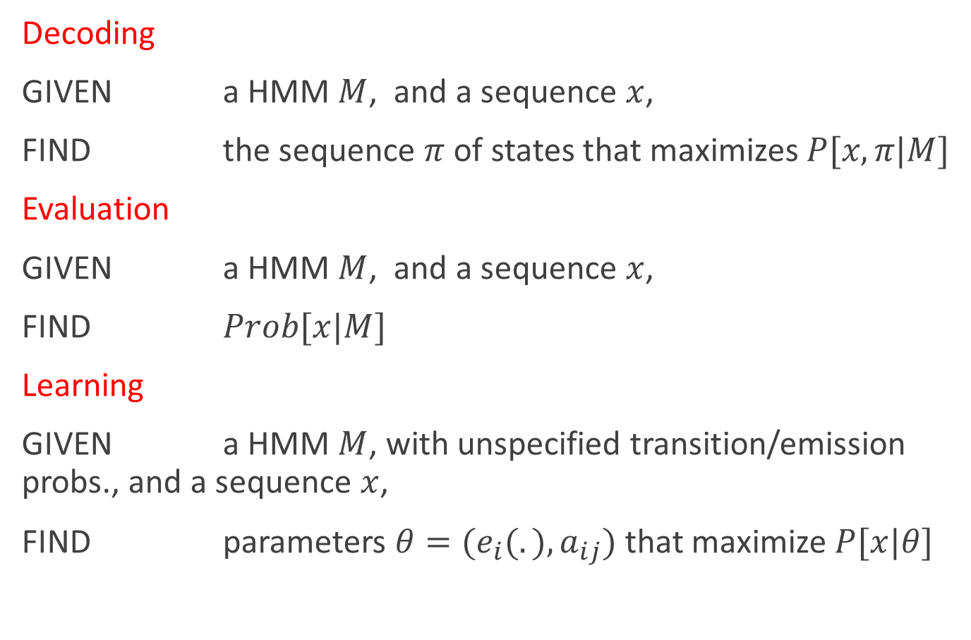
The three main questions on HMMs
Decoding
GIVEN a HMM $M$, and a sequence $x$,
FIND the sequence $π$ of states that maximizes $P[x, π|M]$
Evaluation
GIVEN a HMM $M$, and a sequence $x$,
FIND $Prob[x|M]$
Learning
GIVEN a HMM $M$, with unspecified transition/emission probs., and a sequence $x$,
FIND parameters $θ=(e_{i}(.), a_{ij})$that maximize $P[x|θ]$

Slide 20
Example: Teacher-mood-model
The observation is a probabilistic function of the state.
Situation:
Your school teacher gave three different types of daily homework assignments:
  A: took about 5 minutes to complete
  B: took about 1 hour to complete
  C: took about 3 hours to complete
Your teacher did not reveal openly his mood to you daily, but you knew that your teacher was either in a bad, neutral, or a good mood for a whole day.
Mood changes occurred only overnight.

Slide 21
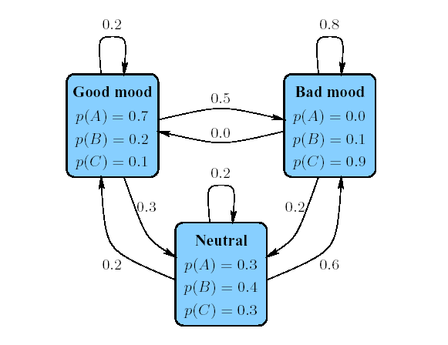
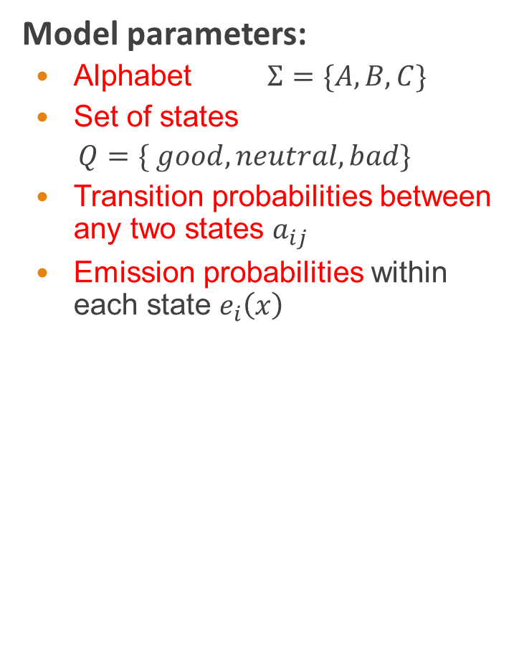
Example: Teacher-mood-model
Model parameters:
  Alphabet $Σ=\{A, B,C\}$
  Set of states
  $$Q=\{ good, neutral, bad\}$$
  Transition probabilities between any two states $a_{ij}$
  Emission probabilities within each state $e_{i}\left(x\right)$

Slide 22
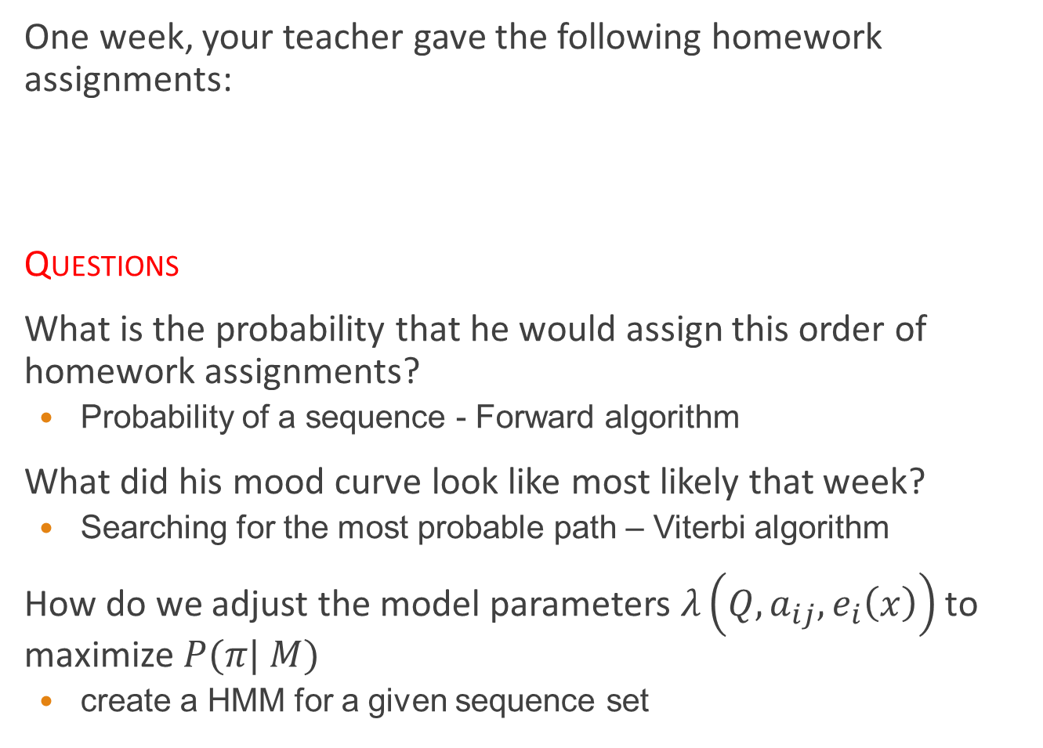
Example: Teacher-mood-model
One week, your teacher gave the following homework assignments:
Questions
What is the probability that he would assign this order of homework assignments?
  Probability of a sequence - Forward algorithm
What did his mood curve look like most likely that week?
  Searching for the most probable path – Viterbi algorithm
How do we adjust the model parameters $λ\left(Q,a_{ij},e_{i}\left(x\right)\right)$to maximize $P(π| M)$
  create a HMM for a given sequence set
Monday | Tuesday | Wednesday | Thursday | Friday
A | C | B | A | C

Slide 23
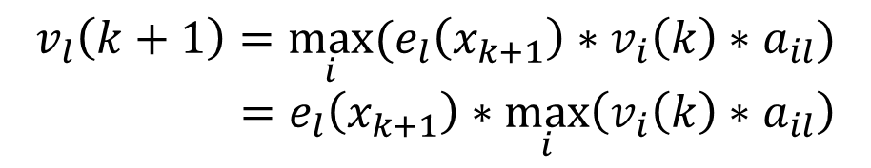
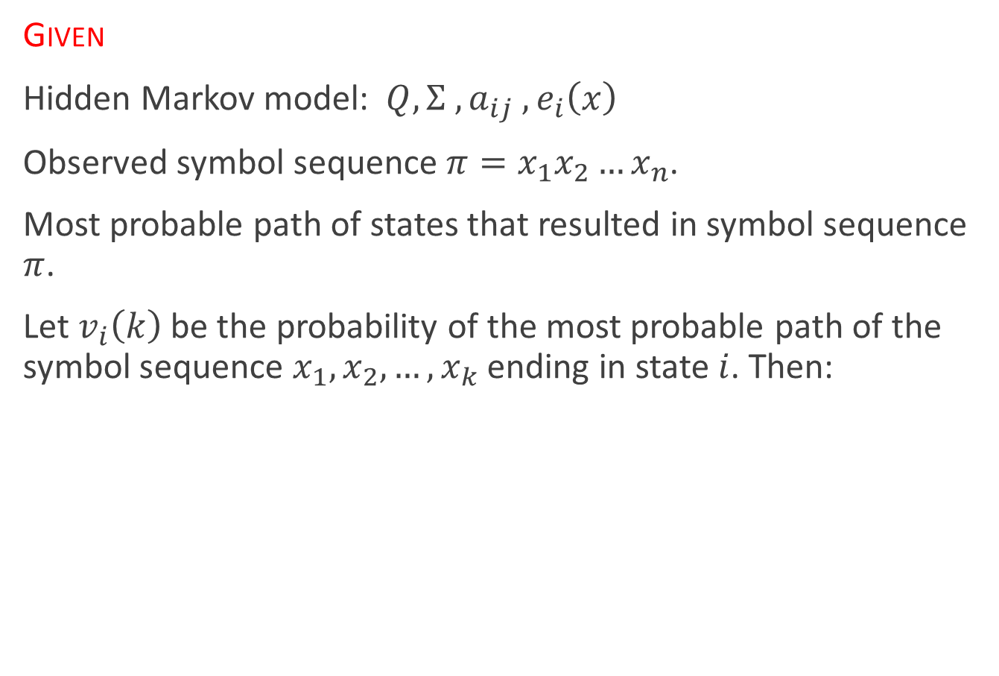
HMM: Viterbi algorithm
Given
Hidden Markov model: $Q,Σ ,a_{ij} , e_{i}\left(x\right)$
Observed symbol sequence $π=x_{1}x_{2}…x_{n}$.
Most probable path of states that resulted in symbol sequence $π$.
Let $v_{i}\left(k\right)$ be the probability of the most probable path of the symbol sequence $x_{1},x_{2},…,x_{k}$ ending in state $i$. Then:
$$v_{l}\left(k+1\right)=\max_{i}{(e_{l}\left(x_{k+1}\right)∗v_{i}\left(k\right)∗a_{il})}$$
$$=e_{l}\left(x_{k+1}\right)∗\max_{i}\left(v_{i}\left(k\right)∗a_{il}\right)$$

Slide 24


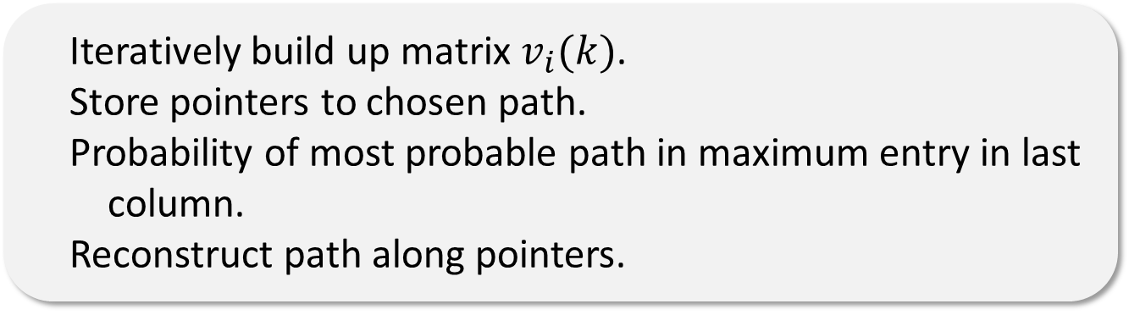
HMM: Viterbi algorithm
Matrix $v_{i}(k)$, where $k∈Q$ and $1≤l≤ n$.
Initialization:
$v_{l}\left(k\right)=e_{l}\left(x_{k}\right)\max_{i}{(v_{i}\left(k − 1\right)∗a_{il}})$for all states $k∈Q,i≥2$.
Algorithm
$$v_{l}\left(1\right)=\frac{e_{l}\left(x_{1}\right)}{\#states}$$
Iteratively build up matrix $v_{i}(k)$.
Store pointers to chosen path.
Probability of most probable path in maximum entry in last column.
Reconstruct path along pointers.

Slide 25
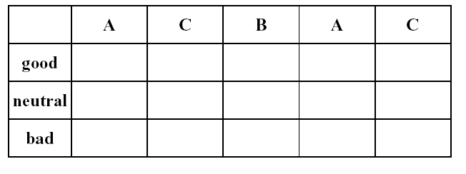
HMM: Viterbi algorithm
Empty table

Slide 26
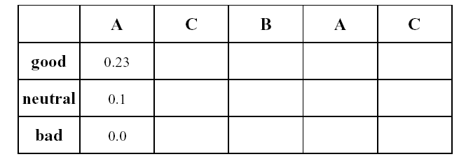

HMM: Viterbi algorithm
Initialization:
$$v_{l}\left(1\right)=\frac{e_{l}\left(A\right)}{\#states}$$

Slide 27
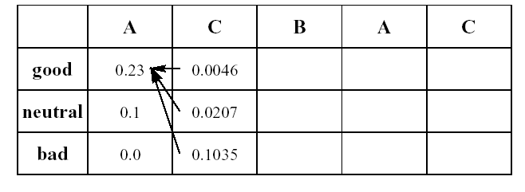

HMM: Viterbi algorithm
$v_{l}\left(2\right)=e_{l}\left(C\right)\max_{i}{(v_{i}\left(1\right)a_{il})}$

Slide 28
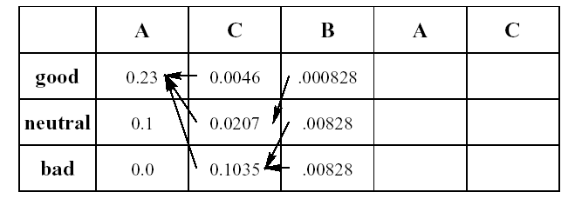

HMM: Viterbi algorithm
$v_{l}\left(3\right)=e_{l}\left(B\right)\max_{i}{(v_{i}\left(2\right)a_{il})}$

Slide 29
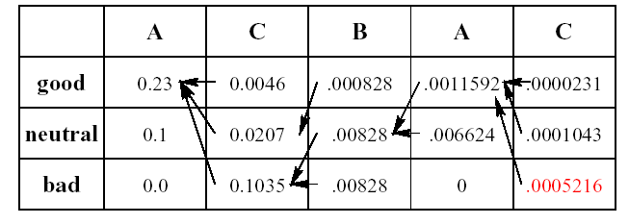
HMM: Viterbi algorithm
Maximum entry in last column

Slide 30
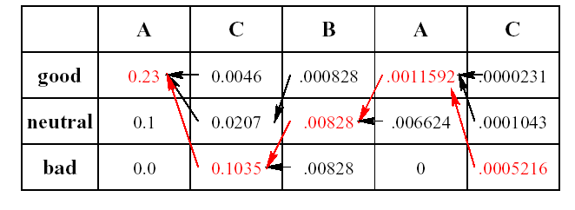
HMM: Viterbi algorithm
Reconstruct path along pointers

Slide 31
HMM: Viterbi algorithm
Question
What did his mood curve look like most likely that week?
Answer
Most probable mood curve:
Day | Monday | Tuesday | Wednesday | Thursday | Friday
Assignment | A | C | B | A | C
Mood | good | bad | neutral | good | bad

Slide 32

HMM: Parameter estimation
Question
How do we know the transition probabilities $a_{ij}$ and the emission probabilities $e_{i}(x)$?
Answer
We use training sequences and construct maximum likelihood estimators.

Slide 33

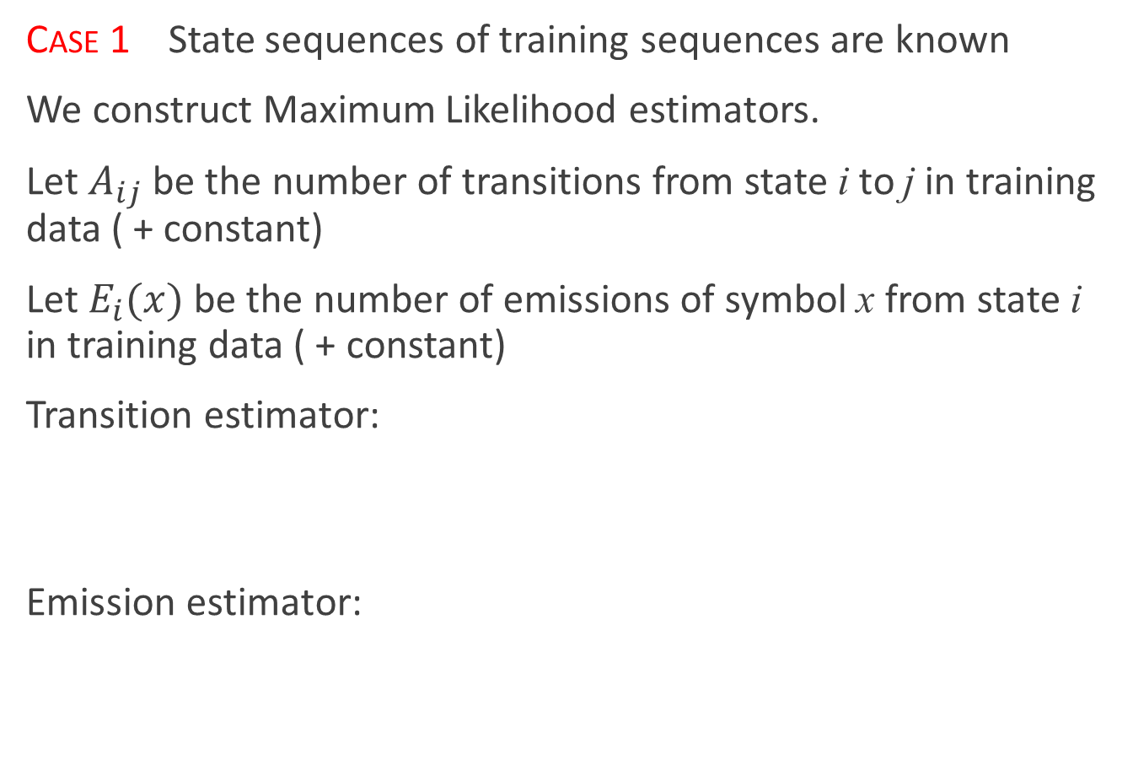
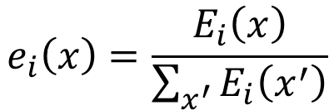
HMM: Parameter estimation
Case 1 State sequences of training sequences are known
We construct Maximum Likelihood estimators.
Let $A_{ij}$ be the number of transitions from state i to j in training data ( + constant)
Let $E_{i}(x)$ be the number of emissions of symbol x from state i in training data ( + constant)
Transition estimator:
Emission estimator:
$$a_{ij}=\frac{A_{ij}}{\sum_{j^{′}}{A_{ij^{′}}}}$$
$$e_{i}\left(x\right)=\frac{E_{i}\left(x\right)}{\sum_{x^{′}}{E_{i}\left(x^{′}\right)}}$$

Slide 34
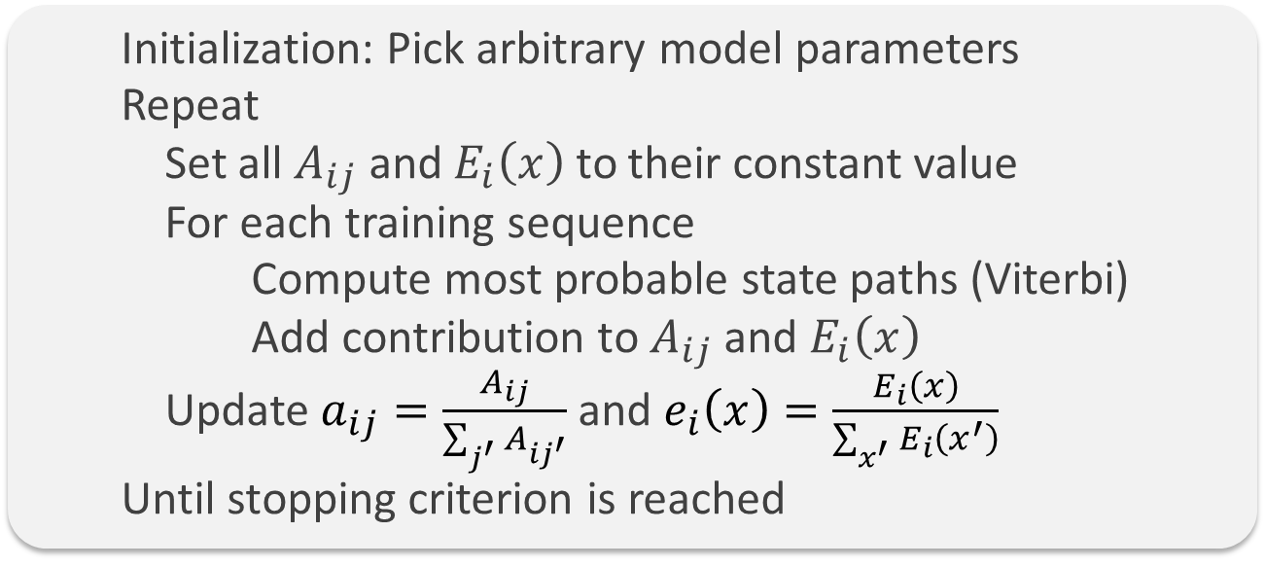
HMM: Parameter estimation
Case 2 State sequences of training sequences are not known
Viterbi training We iteratively use the Viterbi algorithm to compute the most probable paths and set the parameters (from case 1) according to this data
Algorithm sketch:
Initialization: Pick arbitrary model parameters
Repeat
Set all $A_{ij}$ and $E_{i}\left(x\right)$ to their constant value
For each training sequence
Compute most probable state paths (Viterbi)
Add contribution to $A_{ij}$ and $E_{i}\left(x\right)$
Update $a_{ij}=\frac{A_{ij}}{\sum_{j^{′}}{A_{ij^{′}}}}$ and $e_{i}\left(x\right)=\frac{E_{i}\left(x\right)}{\sum_{x^{′}}{E_{i}\left(x^{′}\right)}}$
Until stopping criterion is reached

Slide 35
HMM in ASR
How HMM can used to classify feature sequences to known classes.
  Make a HMM to each class.
By determining the probability of a sequence to the HMMs, we can decide which HMM could most probable generate the sequence.
There are several idea what to model:
  Isolated word recognition ( HMM for each known word)
  Usable just on small dictionaries. (digit recognition etc.)
  Number of states usually >=4. Left-to-right HMM
Monophone acoustic model ( HMM for each phone)
  ~50 HMM
Triphone acoustic model (HMM for each three phone sequence)
  50^3 = 125000 triphones
  each triphone has 3 state

Slide 36
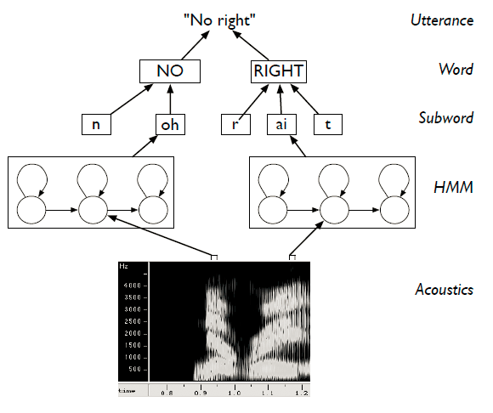
Hierarchical modelling of speech

Slide 37
Outline
Introduction
Speech recognition based on HMM
  Acoustic processing
  Acoustic modeling: Hidden Markov Model
  Language modeling

Slide 38
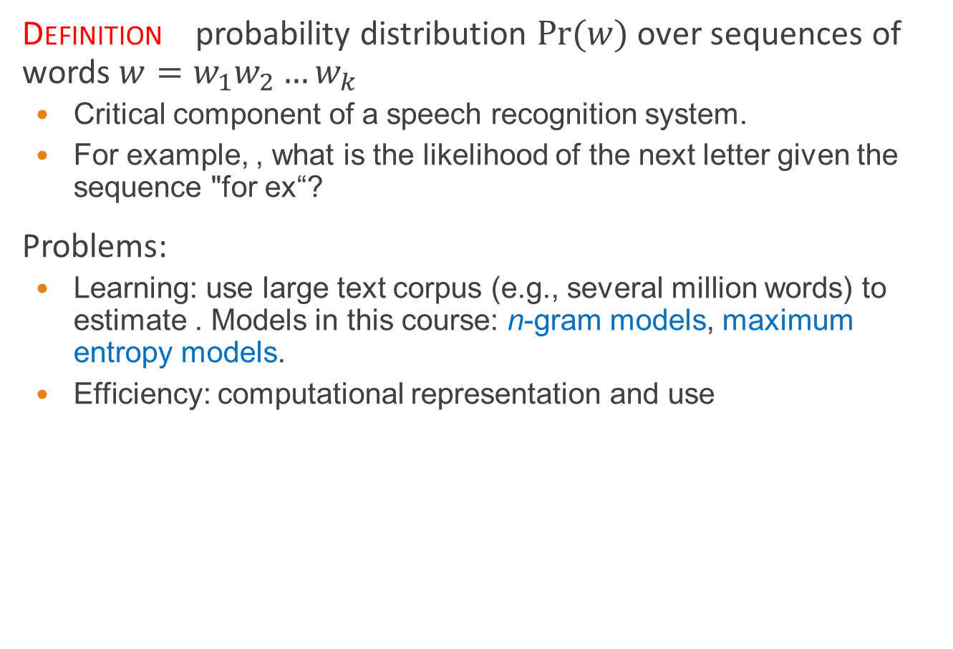
Language models
Definition probability distribution $Pr⁡(w)$ over sequences of words $w=w_{1}w_{2}…w_{k}$
  Critical component of a speech recognition system.
  For example, , what is the likelihood of the next letter given the sequence "for ex“?
Problems:
  Learning: use large text corpus (e.g., several million words) to estimate . Models in this course: n-gram models, maximum entropy models.
  Efficiency: computational representation and use
Field | Unit | Sample sequence | 1-gram sequence | 2-gram sequence | 3-gram sequence
Computational linguistics | word | … to be or not to be … | …, to, be, or, not, to, be, … | …, to be, be or, or not, not to, to be, … | …, to be or, be or not, or not to, not to be, …

Slide 39
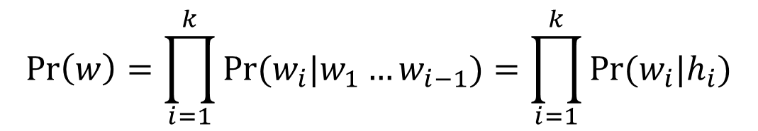

N-Gram models
Definition an n-gram model is a probability distribution based on the nth order Markov assumption
$∀i,\operatorname{Pr}\left(w_{i} | w_{1}…w_{i−1}\right)=\operatorname{Pr}\left(w_{i} | h_{i}\right),\left|h_{i}\right|≤n−1$
  Most widely used language models
Consequence by the chain rule,
$$\operatorname{Pr}\left(w\right)=\prod_{i=1}^{k}{Pr⁡(w_{i}|w_{1}…w_{i−1})}=\prod_{i=1}^{k}{Pr⁡(w_{i}|h_{i})}$$

Slide 40
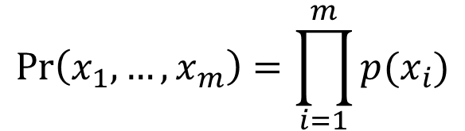
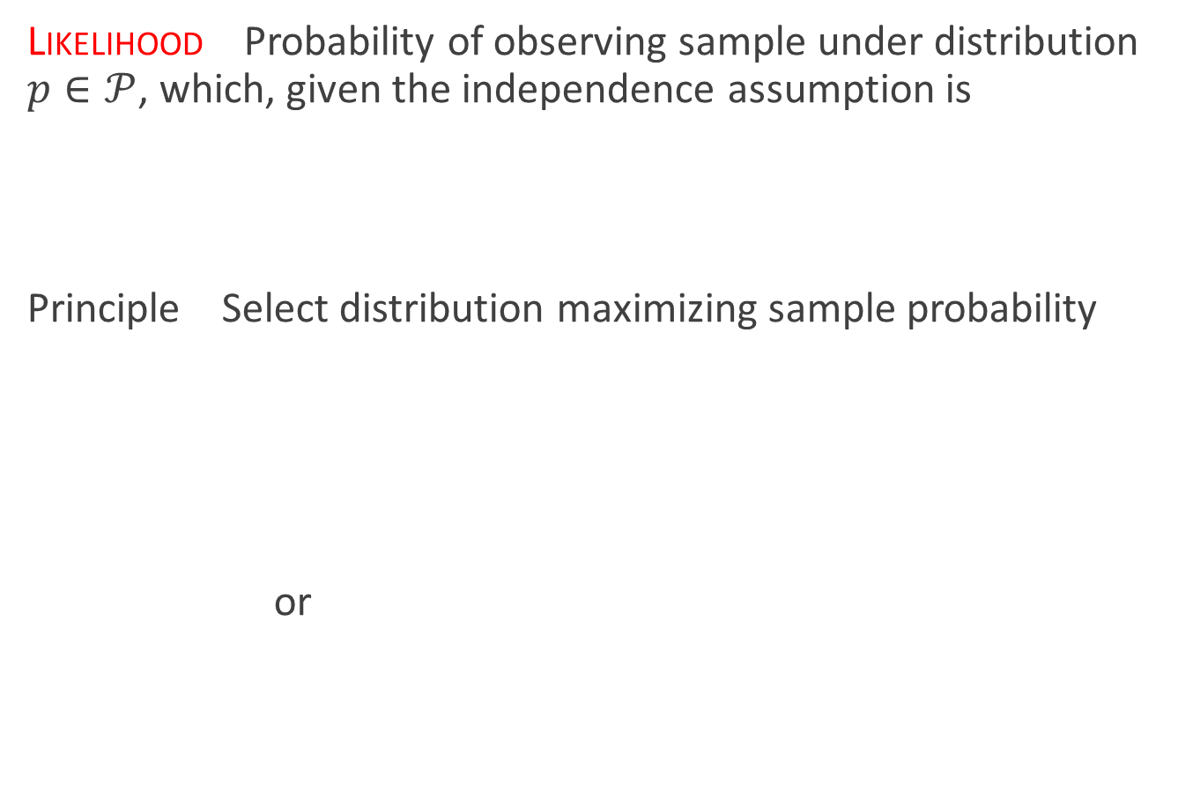

Maximum likelihood
Likelihood Probability of observing sample under distribution $p∈𝒫$, which, given the independence assumption is
Principle Select distribution maximizing sample probability
or
$$\operatorname{Pr}\left(x_{1},…,x_{m}\right)=\prod_{i=1}^{m}{p(x_{i})}$$
$$p^{∗}=\arg{\max_{p∈𝒫}{\prod_{i=1}^{m}{p(x_{i})}}}$$
$$p^{∗}=\arg{\max_{p∈𝒫}{\sum_{i=1}^{m}{\log{p(x_{i})}}}}$$

Slide 41
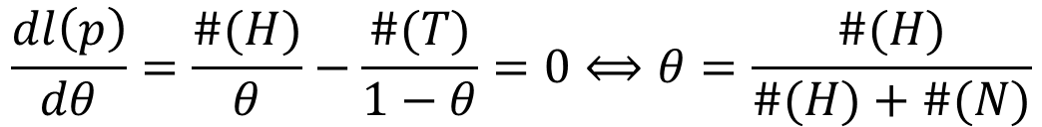
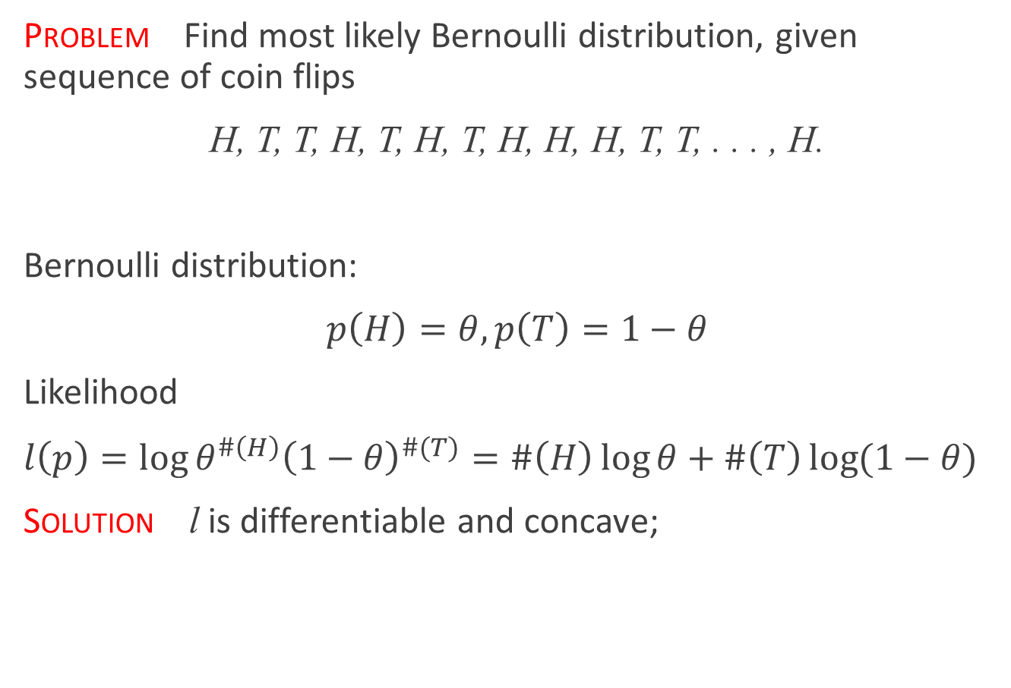
Example: Bernoulli trials
Problem Find most likely Bernoulli distribution, given sequence of coin flips
H, T, T, H, T, H, T, H, H, H, T, T, . . . , H.
Bernoulli distribution:
$p\left(H\right)=θ,p\left(T\right)=1−θ$
Likelihood
$l\left(p\right)=\log{θ^{\#\left(H\right)}{\left(1−θ\right)}^{\#(T)}}=\#\left(H\right)\log{θ}+\#\left(T\right)\log{(1−θ)}$
Solution l is differentiable and concave;
$$\frac{dl\left(p\right)}{dθ}=\frac{\#(H)}{θ}−\frac{\#(T)}{1−θ}=0⟺θ=\frac{\#(H)}{\#(H)+\#(N)}$$

Slide 42
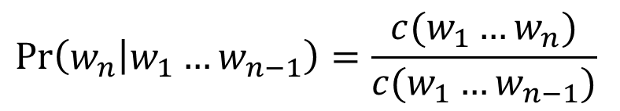

Maximum Likelihood Estimation
Definitions:
  n-gram: sequence of n consecutive words.
  S: sample or corpus of size m
  $c(w_{1}…w_{k})$: count of sequence $w_{1}…w_{k}$
ML estimates For $c\left(w_{1}…w_{k}\right)≠0$
  But, $c\left(w_{1}…w_{k}\right)=0⟹\operatorname{Pr}\left(w_{n} | w_{1}…w_{n−1}\right)=0$!
$$\operatorname{Pr}\left(w_{n} | w_{1}…w_{n−1}\right)=\frac{c(w_{1}…w_{n})}{c(w_{1}…w_{n−1})}$$

Slide 43
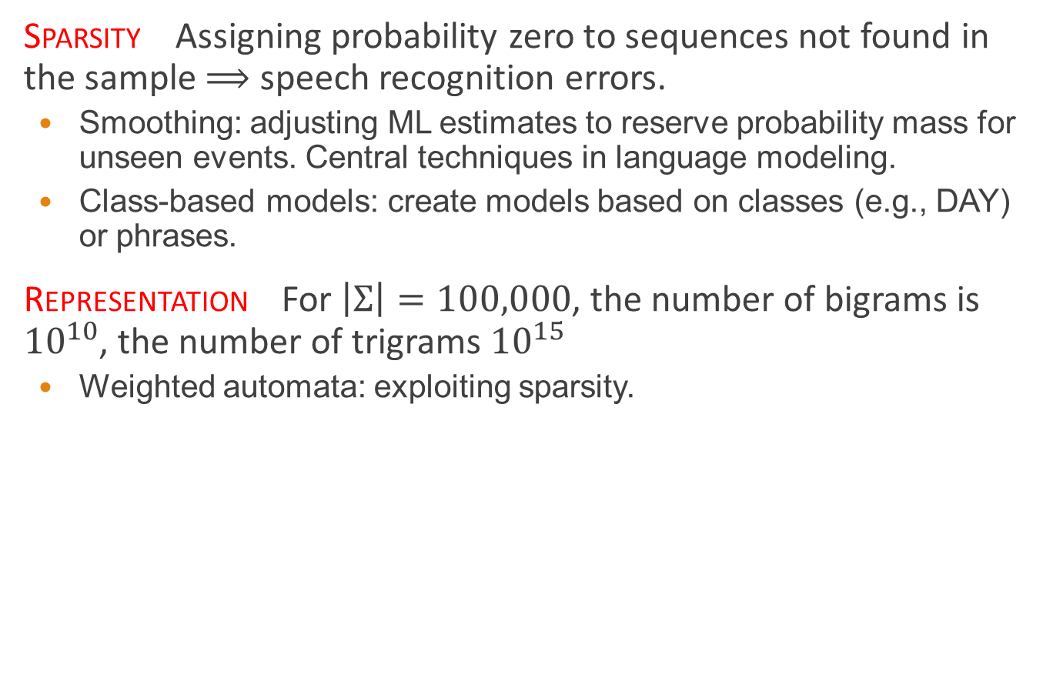
N-Gram model problems
Sparsity Assigning probability zero to sequences not found in the sample $⟹$ speech recognition errors.
  Smoothing: adjusting ML estimates to reserve probability mass for unseen events. Central techniques in language modeling.
  Class-based models: create models based on classes (e.g., DAY) or phrases.
Representation For $\left|Σ\right|=100,000$, the number of bigrams is ${10}^{10}$, the number of trigrams ${10}^{15}$
  Weighted automata: exploiting sparsity.

Slide 44
Smoothing techniques
Typical form: interpolation of n-gram models, e.g., trigram, bigram, unigram frequencies.
Some widely used techniques:
  Katz Back-off models (Katz, 1987).
  Interpolated models (Jelinek and Mercer, 1980).
  Kneser-Ney models (Kneser and Ney, 1995).
$$\operatorname{Pr}\left(w_{3} | w_{1}w_{2}\right)=α_{1}c\left(w_{3} | w_{1}w_{2}\right)+α_{2}c\left(w_{3} | w_{2}\right)+α_{3}c(w_{3})$$

